Slide 2
UNIT 4

Slide 3
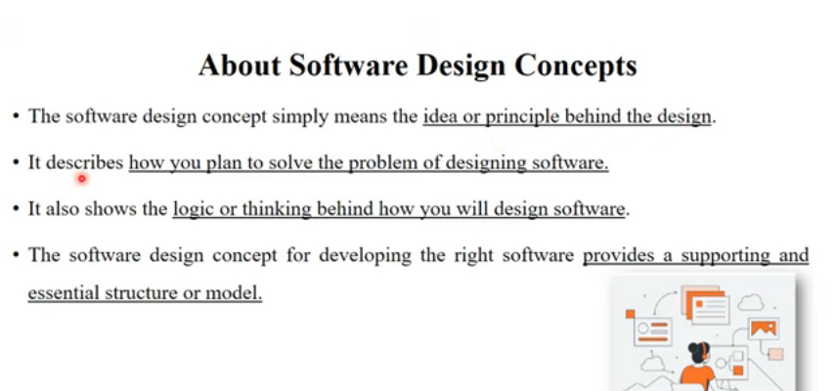

Slide 6
Fundamental Software Design Concepts
Abstraction
A solution is stated in large terms using the language of the problem environment at the highest level abstraction.
The lower level of abstraction provides a more detail description of the solution.
A sequence of instruction that contain a specific and limited function refers in a procedural abstraction.
A collection of data that describes a data object is a data abstraction.

Slide 8
Architecture
The complete structure of the software is known as software architecture.
Structure provides conceptual integrity for a system in a number of ways.
The architecture is the structure of program modules where they interact with each other in a specialized way.
The components use the structure of data.
The aim of the software design is to obtain an architectural framework of a system.
The more detailed design activities are conducted from the framework

Slide 11
Patterns
A design pattern describes a design structure and that structure solves a particular design problem in a specified content.
Modularity
A software is separately divided into name and addressable components. Sometime they are called as modules which integrate to satisfy the problem requirements.
Modularity is the single attribute of a software that permits a program to be managed easily.
Information hiding
Modules must be specified and designed so that the information like algorithm and data presented in a module is not accessible for other modules not requiring that information.

Slide 12
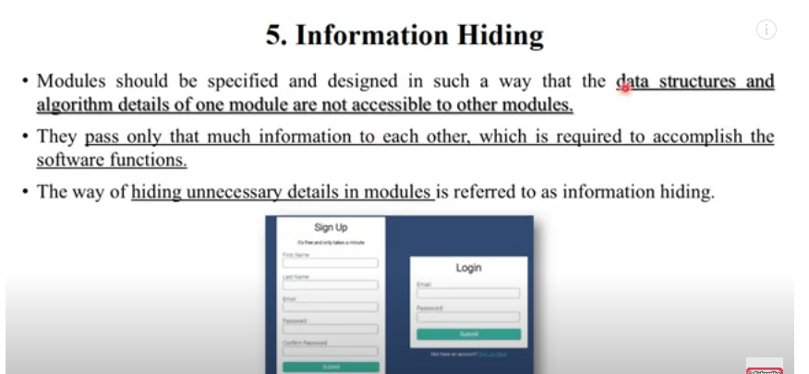

Slide 13
Functional independence
The functional independence is the concept of separation and related to the concept of modularity,
abstraction and information hiding.
The functional independence is accessed using two criteria i.e Cohesion and coupling.
Cohesion
Cohesion is an extension of the information hiding concept.
A cohesive module performs a single task and it requires a small interaction with the other
components in other parts of the program.
Coupling
Coupling is an indication of interconnection between modules in a structure of software.

Slide 15
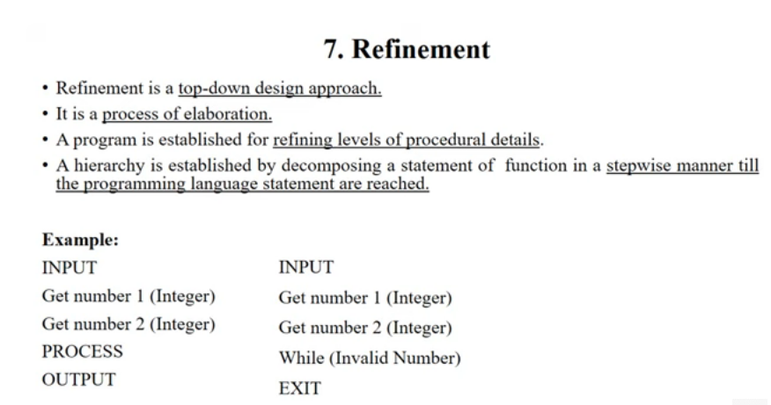

Slide 16
Refinement
Refinement is a top-down design approach.
It is a process of elaboration.
A program is established for refining levels of procedural details.
A hierarchy is established by decomposing a statement of function in a stepwise manner till the programming language statement are reached.
Refactoring
It is a reorganization technique which simplifies the design of components without changing its function behaviour.
Refactoring is the process of changing the software system in a way that it does not change the external behaviour of the code still improves its internal structure.

Slide 17
Design Classes
The model of software is defined as a set of design classes.
Every class describes the elements of problem domain and that focus on features of the problem which are user visible.
User interface classes
Define all abstractions that are necessary for human computer interaction.
Business domain classes are often refinements of the analysis classes.
The classes identify the attributes and services that are required to implement some element of the business domain.
Process classes implement lower-level business abstractions required to fully manage the business domain classes.

Slide 18
Persistent classes represent data stores that will persist beyond the execution of the software
System classes implement software management and control functions that enable the system to operate and communicate within its computing environment.
They define four characteristics of a well formed design class
Complete and sufficient
Primitiveness
High cohesion
Low coupling

Slide 20
Design Model
Design modeling in software engineering represents the features of the software that helps engineer to develop it effectively, the architecture, the user interface, and the component level detail.
Design modeling provides a variety of different views of the system like architecture plan for home or building.
Different methods like data-driven, pattern-driven, or object-oriented methods are used for constructing the design model. All these methods use set of design principles for designing a model.

Slide 23
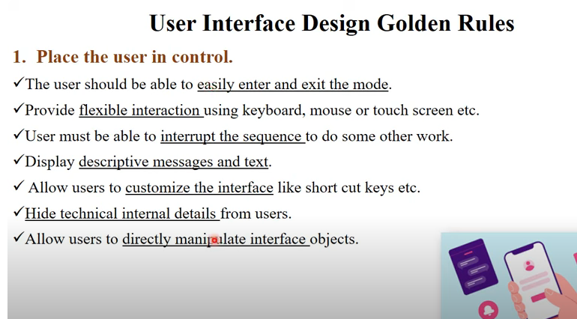

Slide 26
Design Model Elements
Data elements
Data model --> data structures
Data model --> database architecture
Architectural elements
Application domain
Analysis classes, their relationships, collaborations and behaviors are transformed into design realizations
Patterns and “styles”
Interface elements
the user interface (UI)
external interfaces to other systems, devices, networks or other producers or consumers of information
internal interfaces between various design components.
Component elements
Deployment elements

Slide 27
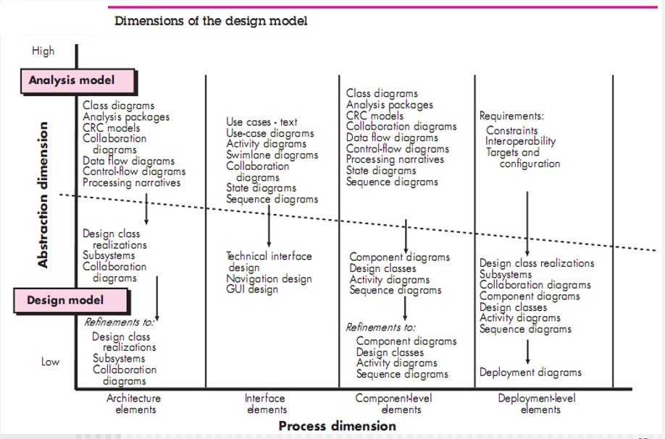

Slide 28
Data Modeling
examines data objects independently of processing
focuses attention on the data domain
creates a model at the customer’s level of abstraction
indicates how data objects relate to one another

Slide 29
What is a Data Object?
a representation of almost any composite information that must be understood by software.
composite information—something that has a number of different properties or attributes
can be an external entity (e.g., anything that produces or consumes information), a thing (e.g., a report or a display), an occurrence (e.g., a telephone call) or event (e.g., an alarm), a role (e.g., salesperson), an organizational unit (e.g., accounting department), a place (e.g., a warehouse), or a structure (e.g., a file).
The description of the data object incorporates the data object and all of its attributes.
A data object encapsulates data only—there is no reference within a data object to operations that act on the data.

Slide 30
Data Objects and Attributes
A data object contains a set of attributes that act as an aspect, quality, characteristic, or descriptor of the object
object: automobile
attributes:
make
model
body type
price
options code

Slide 31
What is a Relationship?
Data objects are connected to one another in different ways.
A connection is established between person and car because the two objects are related.
A person owns a car
A person is insured to drive a car
The relationships owns and insured to drive define the relevant connections between person and car.
Several instances of a relationship can exist
Objects can be related in many different ways

Slide 32
Architectural Elements
The architectural model [Sha96] is derived from three sources:
information about the application domain for the software to be built;
specific requirements model elements such as data flow diagrams or analysis classes, their relationships and collaborations for the problem at hand, and
the availability of architectural patterns (Chapter 16) and styles (Chapter 13).

Slide 33
Interface Elements
Interface is a set of operations that describes the externally observable behavior of a class and provides access to its public operations
Important elements
User interface (UI)
External interfaces to other systems
Internal interfaces between various design components
Modeled using UML communication diagrams (called collaboration diagrams in UML 1.x)

Slide 34
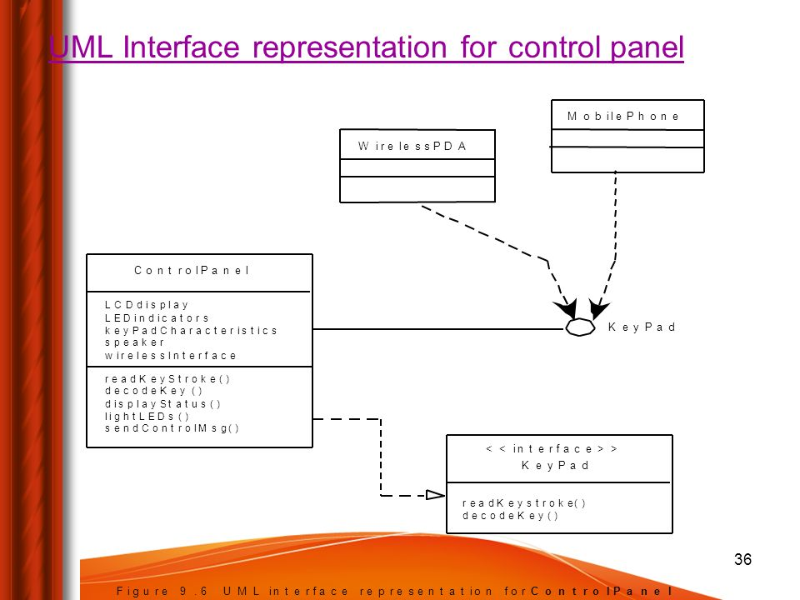
Interface Elements

Slide 35
Component Elements
Describes the internal detail of each software component
Defines
Data structures for all local data objects
Algorithmic detail for all component processing functions
Interface that allows access to all component operations
Modeled using UML component diagrams, UML activity diagrams, pseudocode (PDL), and sometimes flowcharts

Slide 36
Component Elements

Slide 37
Deployment Elements
Indicates how software functionality and subsystems will be allocated within the physical computing environment
Modeled using UML deployment diagrams
Descriptor form deployment diagrams show the computing environment but does not indicate configuration details
Instance form deployment diagrams identifying specific named hardware configurations are developed during the latter stages of design

Slide 38
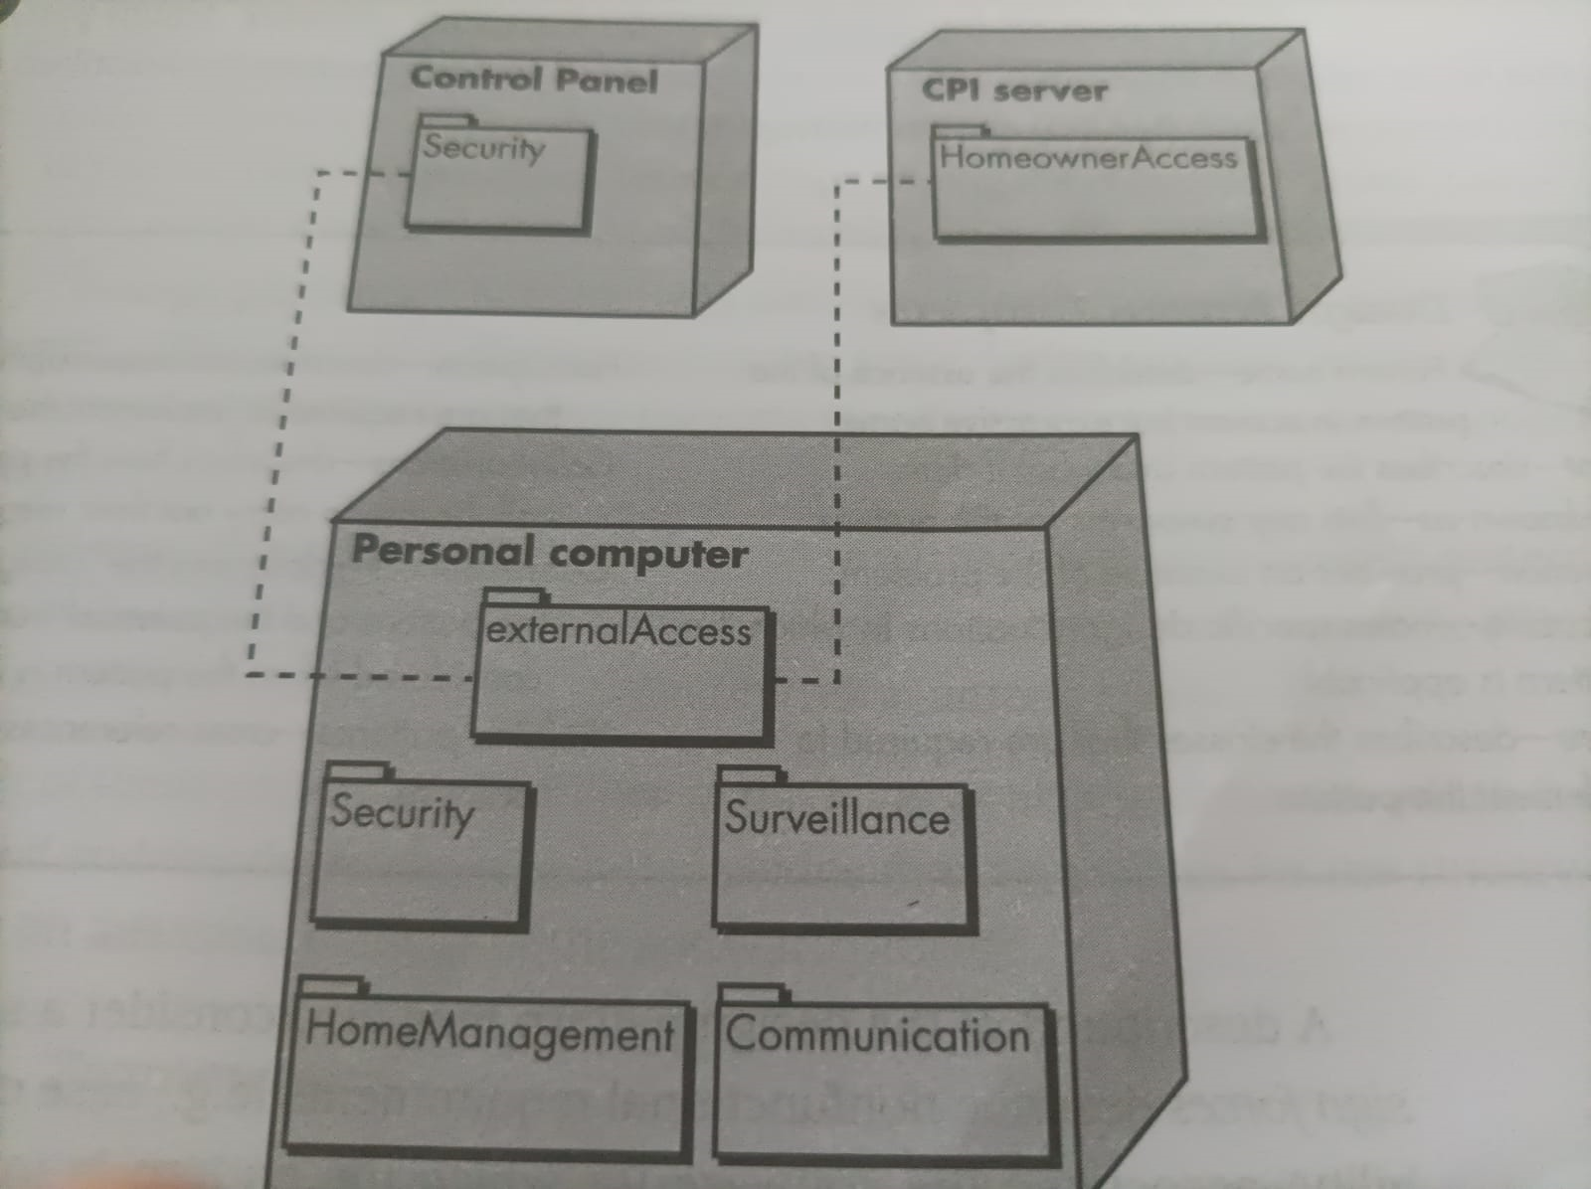
Deployment Elements

Slide 39
Why Architecture?
The architecture is not the operational software. Rather, it is a representation that enables a software engineer to:
(1) analyze the effectiveness of the design in meeting its stated requirements,
(2) consider architectural alternatives at a stage when making design changes is still relatively easy, and
(3) reduce the risks associated with the construction of the software.

Slide 40
Why is Architecture Important?
Representations of software architecture are an enabler for communication between all parties (stakeholders) interested in the development of a computer-based system.
The architecture highlights early design decisions that will have a profound impact on all software engineering work that follows and, as important, on the ultimate success of the system as an operational entity.
Architecture “constitutes a relatively small, intellectually graspable mode of how the system is structured and how its components work together”

Slide 41
Architectural Descriptions
The IEEE Computer Society has proposed IEEE-Std-1471-2000, Recommended Practice for Architectural Description of Software-Intensive System
to establish a conceptual framework and vocabulary for use during the design of software architecture,
to provide detailed guidelines for representing an architectural description and
to encourage sound architectural design practices.
The IEEE Standard defines an architectural description (AD) as a “a collection of products to document an architecture.”
The description itself is represented using multiple views, where each view is “a representation of a whole system from the perspective of a related set of [stakeholder] concerns.”

Slide 42
Data Design
The data design action translates data defined as part of the analysis model into data structures at the software component level and. When necessary into a database architecture at the application level.
Data Design at the Architectural Level
The challenge in data design is to extract useful information from this data environment, particularly when the information desired is cross-functional.
To solve this challenge, the business IT community has developed data mining techniques, also called knowledge discovery in database (KDD) , that navigate through existing databases in an attempt to extract appropriate business-level information. An alternative solution, called a data warehouse, adds an additional layer to the data architecture.
A data warehouse is a separate data environment that is not directly integrated with day –to-day application but encompasses all data used by a business.

Slide 43
Data Design at the Component Level
Data design at the component level focuses on the representation of the data structures that are directly accessed by one or more software components. We consider the following set of principles (adapted from for data specification):
1. The systematic analysis principles applied to function and behavior should also be applied to data.
2. All data structure and the operations to be performed on each should be identified.
3. A mechanism for defining the content of each data object should be established and used to define both data and the operation applied it.
4. Low-level design decision should be known only to those modules that must make direct use of the data contained within the structure.
5. The representation of a data structure should be known only to those modules that must make direct use of the data contained within the structure.
6. A library of useful data structures and the operations that may be applied to them should be developed.
7. A software design and programming language should support the specification and realization of abstract data types.

Slide 44
Architectural Styles
Each style describes a system category that encompasses: (1) a set of components (e.g., a database, computational modules) that perform a function required by a system, (2) a set of connectors that enable “communication, coordination and cooperation” among components, (3) constraints that define how components can be integrated to form the system, and (4) semantic models that enable a designer to understand the overall properties of a system by analyzing the known properties of its constituent parts.
Data-centered architectures
Data flow architectures
Call and return architectures
Object-oriented architectures
Layered architectures

Slide 45
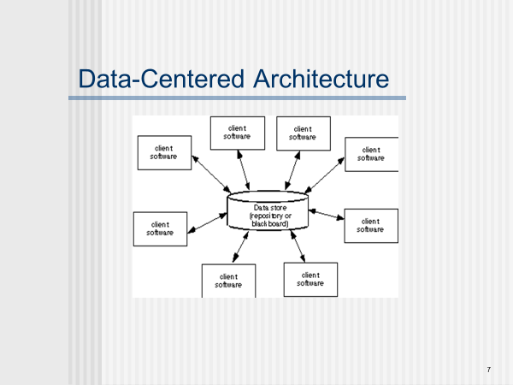

Slide 47
Data-flow architecture
The architecture is applied when input data are to be transformed through a series of computational or manipulate components into output data.
A pipe and filter structure has a set of components, called filters, connected by pipes that transmit data from one component to accept data input of a certain form , and produces data output ( to the next filters) of a specified form.
However, the filter does not require knowledge of the workings of its neighboring filters.

Slide 48
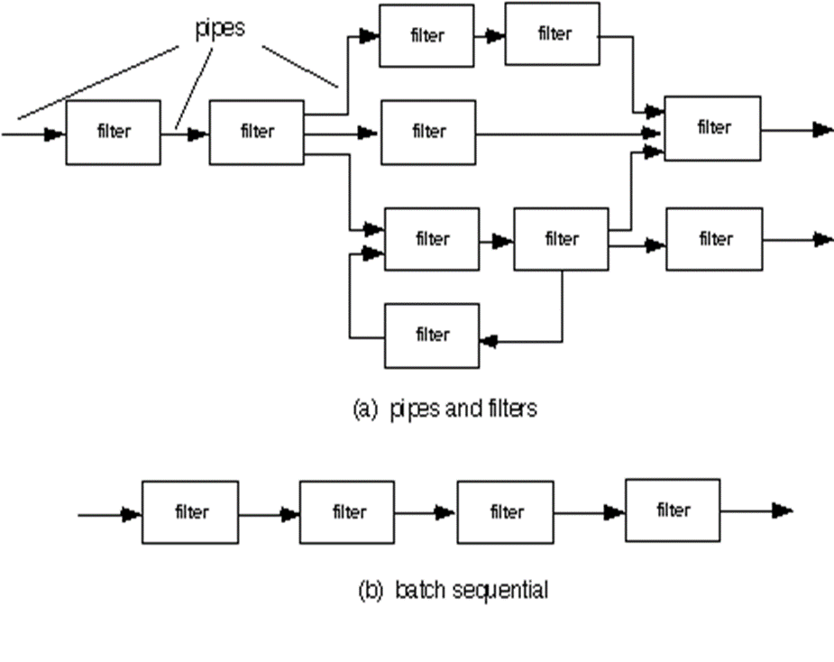

Slide 50
Call and return architecture
This architectural style enables a software designer (system architect) to achieve a program structure that is relatively easy to modify and scale.
Two sub styles within category:
• Main programs/ subprograms architecture. This classic program structure decomposes functions into a control hierarchy where a “main” program invokes a number of program components, which in turn may invoke still other components.
• Remote procedure called architecture. The components of a main program/sub- program architecture are distributed across multiple computers on a network.

Slide 51
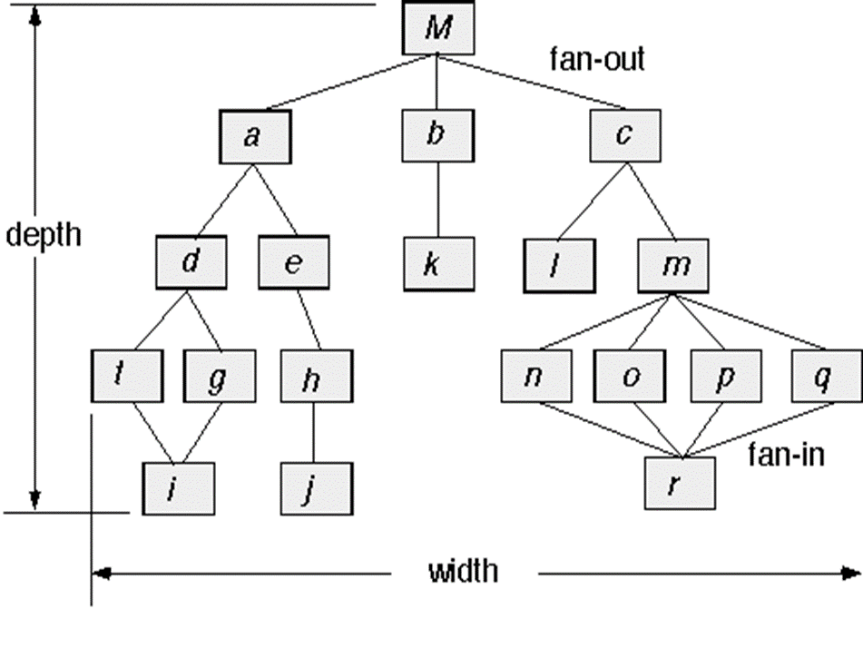

Slide 52
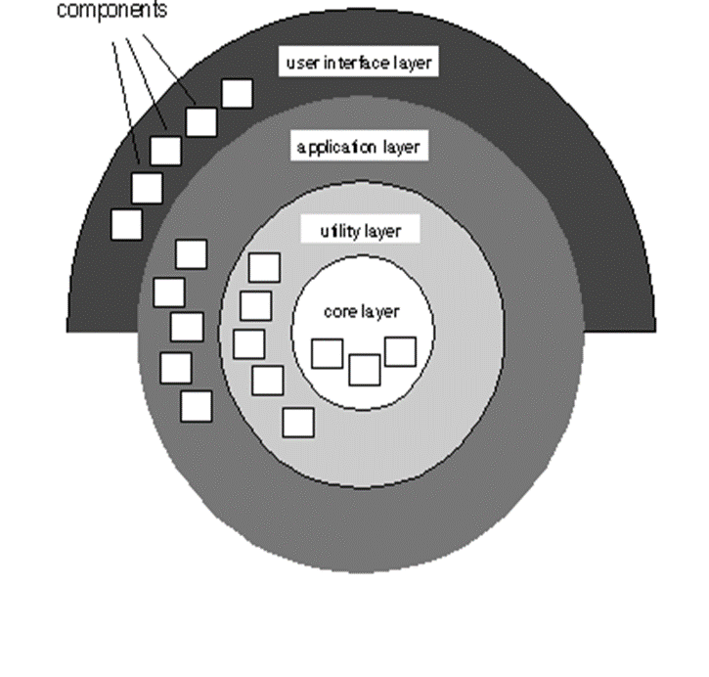
Layered architecture The components of a system encapsulate data and the operations that must be applied to manipulate the data. Communication and coordination between components is accomplished via message passing.

